Slide 1

DressSense.AI
By: Team Hawker

Slide 2
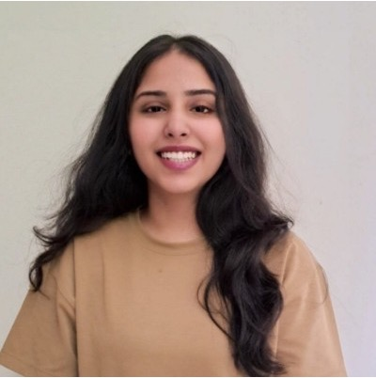
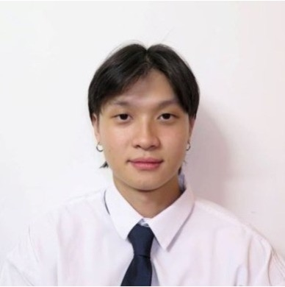


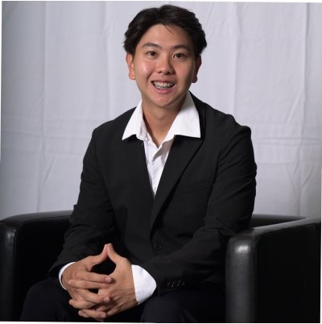
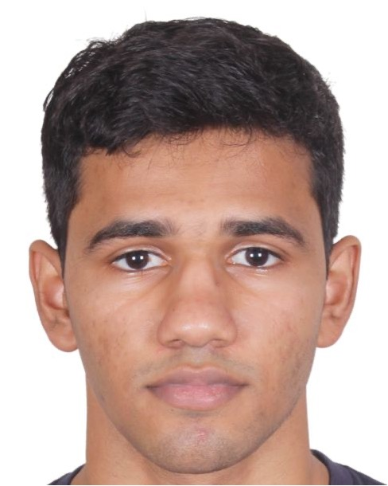
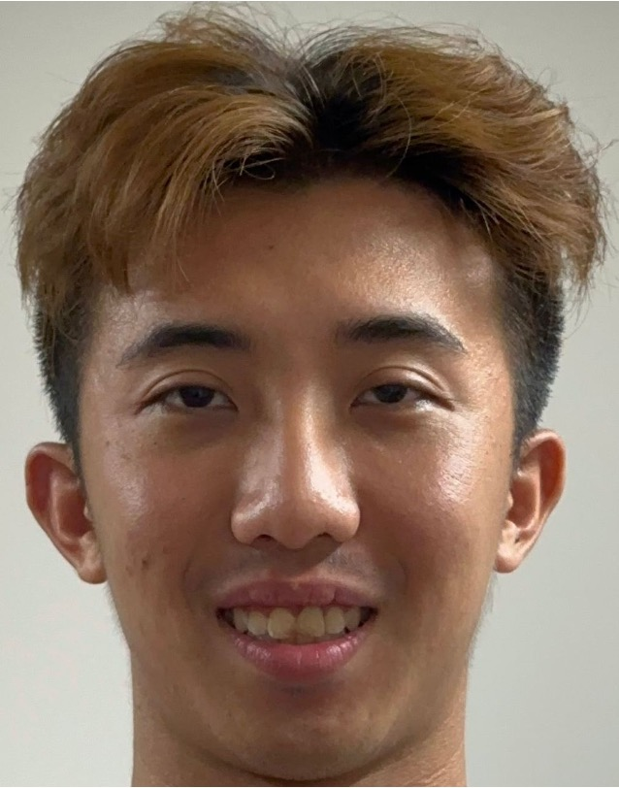
Team Hawker

Slide 3
TABLE OF CONTENTS
01
Background
02
Our Solution: DressSense.AI
03
Solution Demo
04
Why DressSense.AI

Slide 4
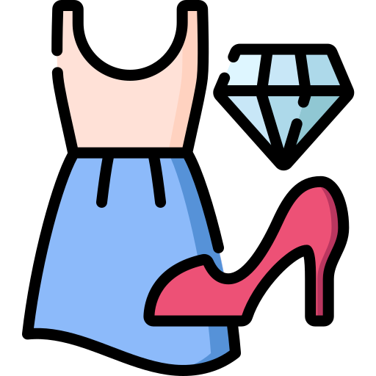
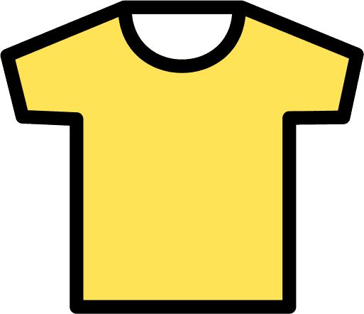
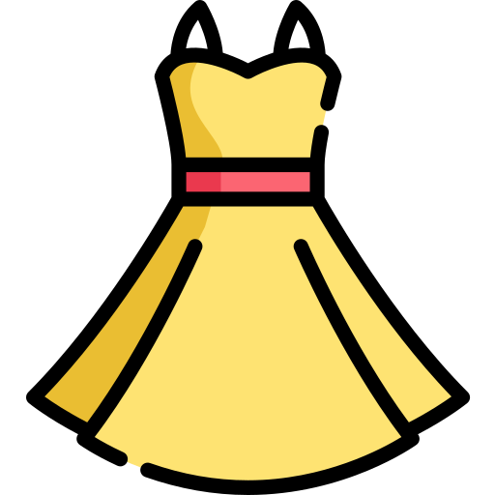
01
Background: The Problem

Slide 5

FASHION IS OUR IDENTITY
We use fashion as an expression of ourselves, and it represents us as people

Slide 6
57%
of people are insecure about the way they look

Slide 7
29%
of people don’t feel confident when shopping for clothes

Slide 8
15%
of all non-school related usage of student-debt funds is for clothing

Slide 9
— CEO Suite
“When doing business in Asia, dressing appropriately for business meetings is critical to your success. Wearing the wrong attire can easily break your reputation and damage your credibility.”

Slide 10



A PROBLEM PLAGUING THE MASSES
STUDENTS
PROFESSIONALS
PARENTS

Slide 11
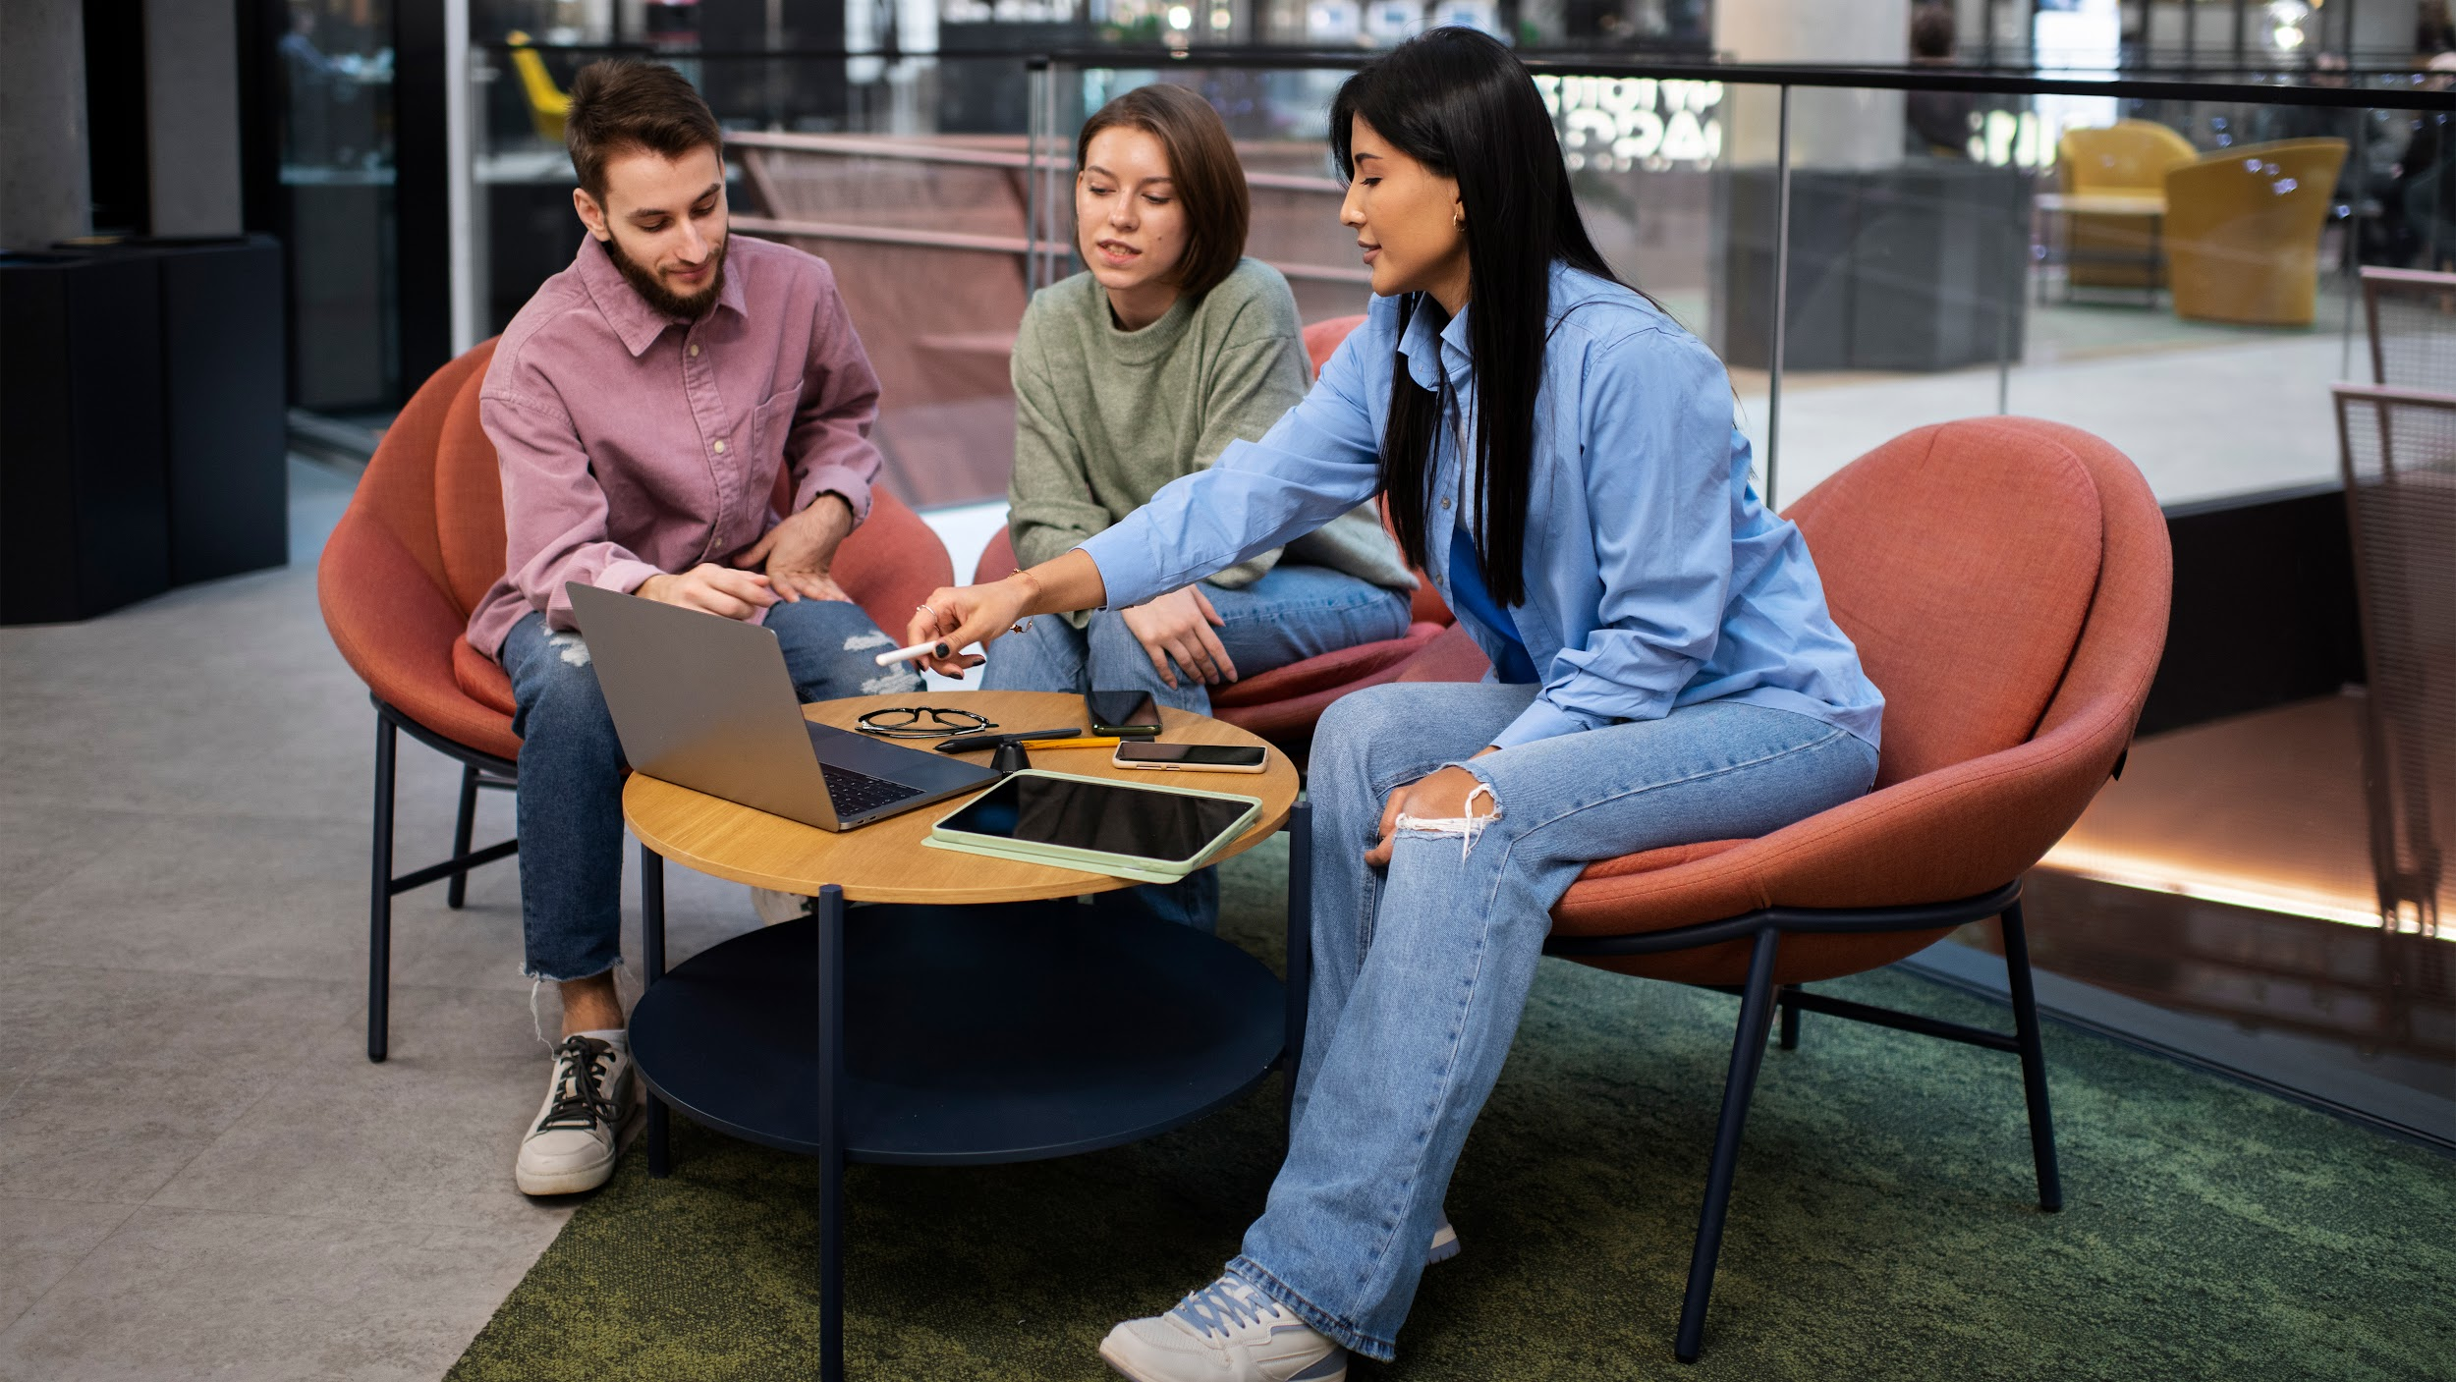

Solving the problem

Slide 12



FAST FASHION
10%
64%
35%
of global CO2 emissions are caused by the fashion industry
of all clothes produced annually are sent to the landfills
of global microplastics are from the fashion industry

Slide 13
We went from solving a day to day problem….. To saving the world one closet at a time

Slide 14
01
Background: The Requirements

Slide 15
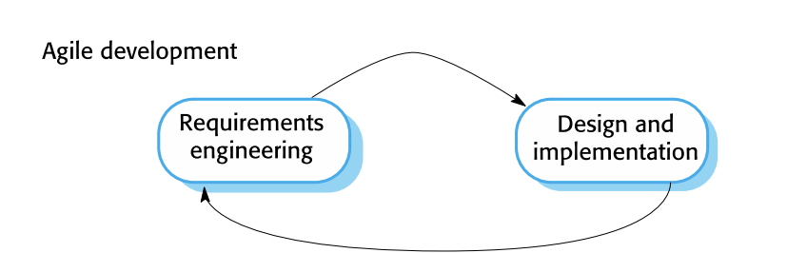
HOW?

Slide 16
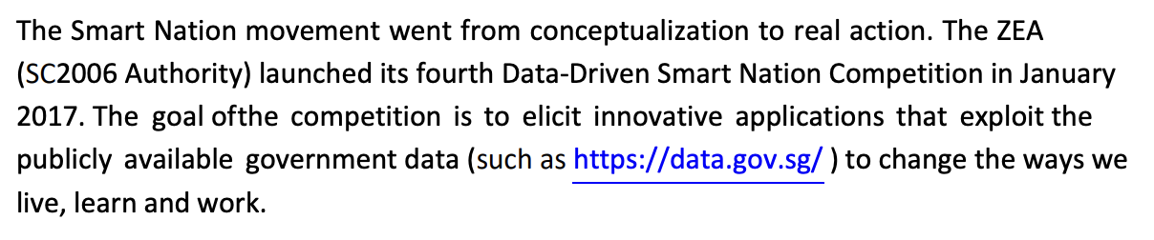
TASKING FROM THE ZEA
LIVE
LEARN
WORK
CHANGE THE WAY WE……

Slide 17
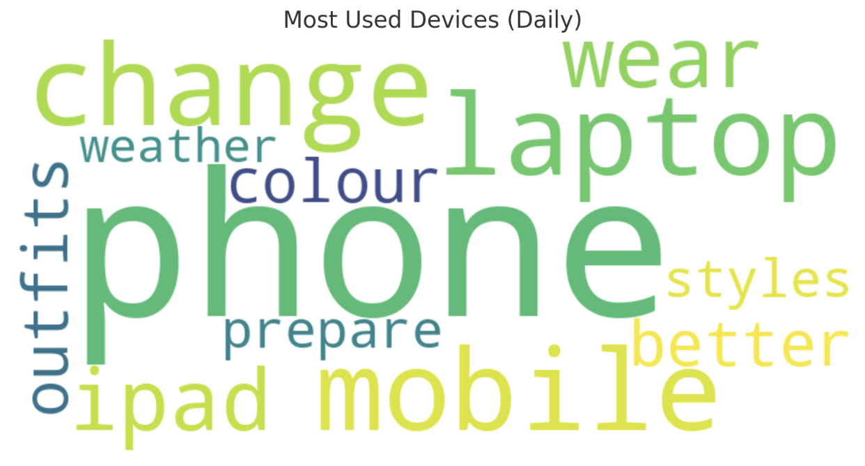
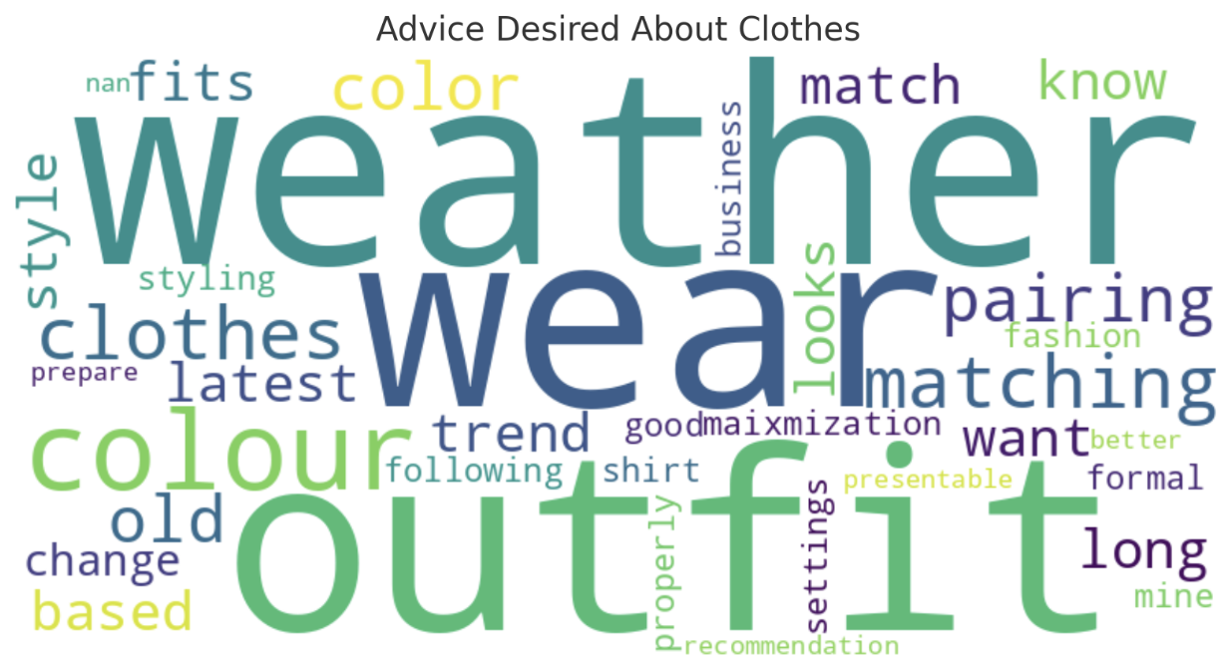
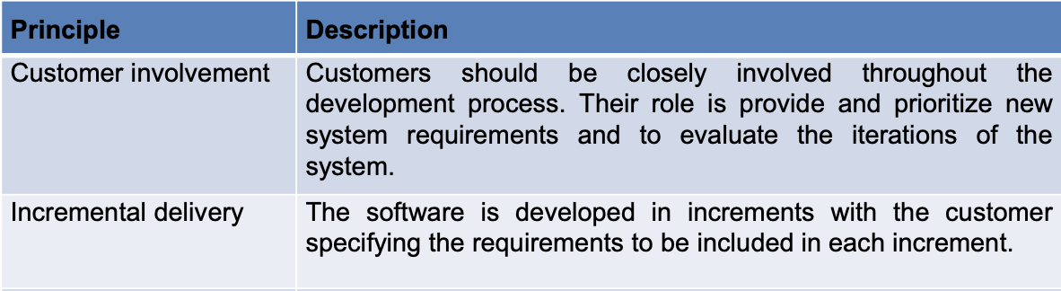
Primary Research

Slide 18


Competitor Analysis
Acloset
YouCame
Only limited to online parsing and no information about personal wardrobe
Limited personalization, just imposes faces on different clothes

Slide 19
Requirements
DressSense.AI Requirements
Easily usable and Accessible | The solution must be accessible on all types of mobile devices, and have a supplementary website for additional features
Personalization and Optimization | The solution must be personalized to the user’s closet, store their information, and tend to their closet on a personal level
Helps reduce the wastage of clothing | Solution must include methods of encouraging alternatives to throwing away clothes
App is a feasible business venture, with scalability | Solution must be commercially feasible (financial, implementation..etc) and must have the potential for scalability)

Slide 20
02
Solution: DressSense.Ai

Slide 21





Outfit Recommender
Marketplace
Fashion Chatbot (MIFFY)
Outfit Rater
Personalized Closet
Mobile App

Slide 22

Outfit Recommender
Fashion Chatbot (MIFFY)
Outfit Rater
Hairstyle Checker
Website

Slide 23







OUR TECH STACK
Frontend
Backend
Mobile application front-end
Deployment and Serverless Functions
Scalable front-end for the
website
Backend Database, User Authentication
Easily Scalable, High-Performance and Extensible
Fine-tuned LLM for creation of text

Slide 24




OUR APIs
API’s
OpenAI
FB
Marketplace
Data.Gov.Sg
Replicate

Slide 25
How does it solve the problem?
01
Outfit Recommendation and Rating
Effectively helping people choose outfits
02
Closet Optimization and Marketplace
Maximizes existing options revitalizing the outfits
Allows people to easily sell their clothes for real money

Slide 26
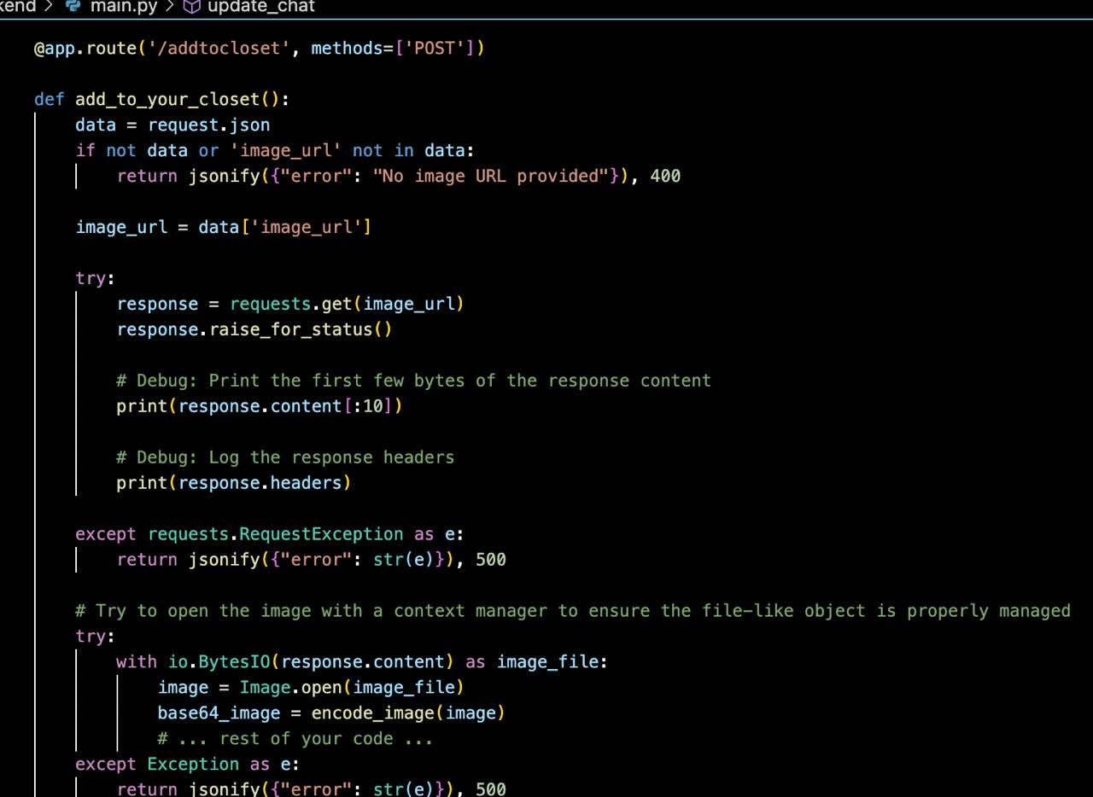
Good SE Principles
Modularity
1
Breaking a software system into smaller, self-contained, and reusable modules

Slide 27
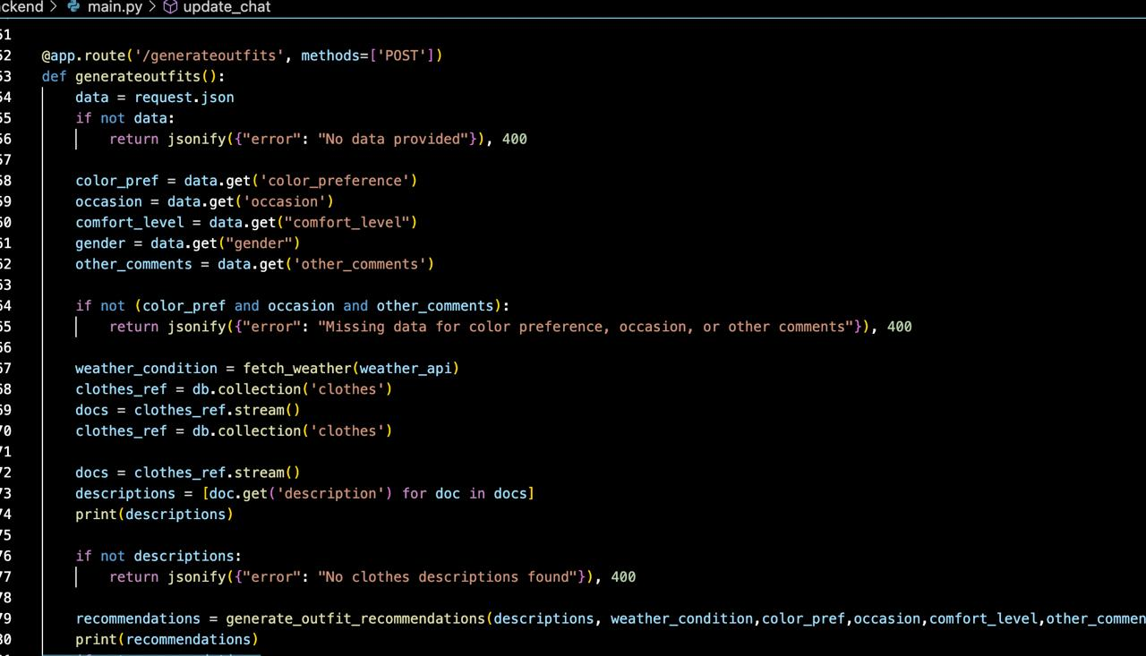
Good SE Principles
Loose-Coupling
2
Reduce dependencies between components of a system, making it more modular and easier to change, maintain, and scale

Slide 28
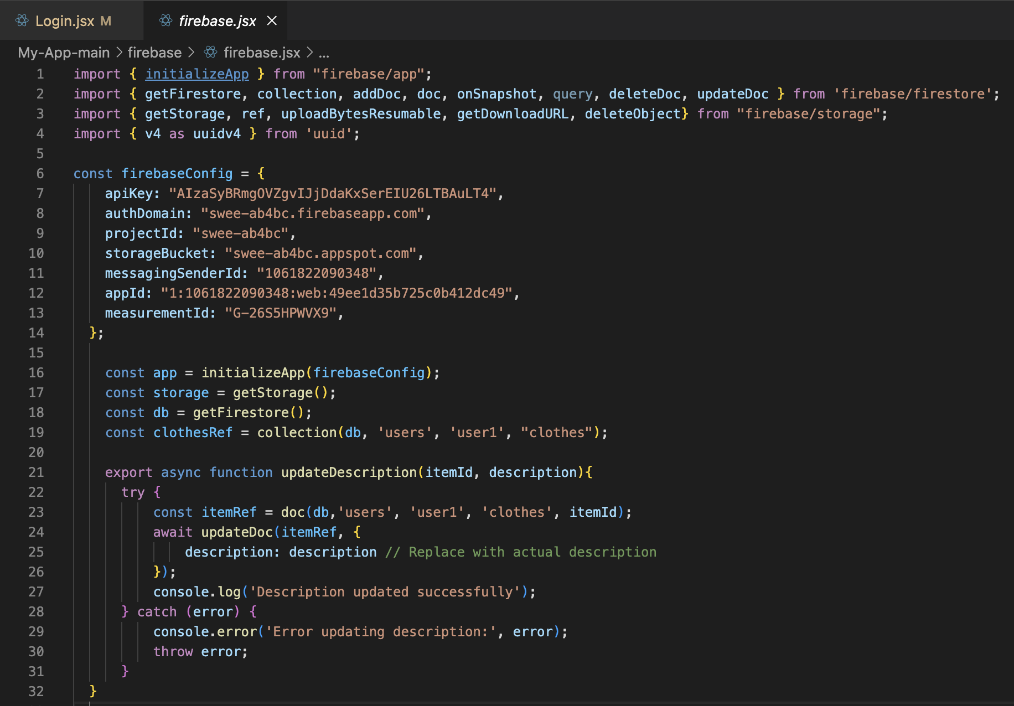
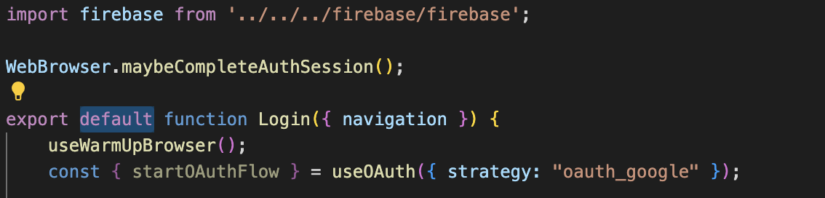
Good SE Principles
Reusability
3
Ability to use existing components without having to modify them extensively

Slide 29
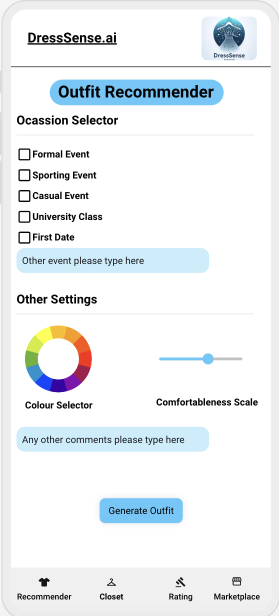
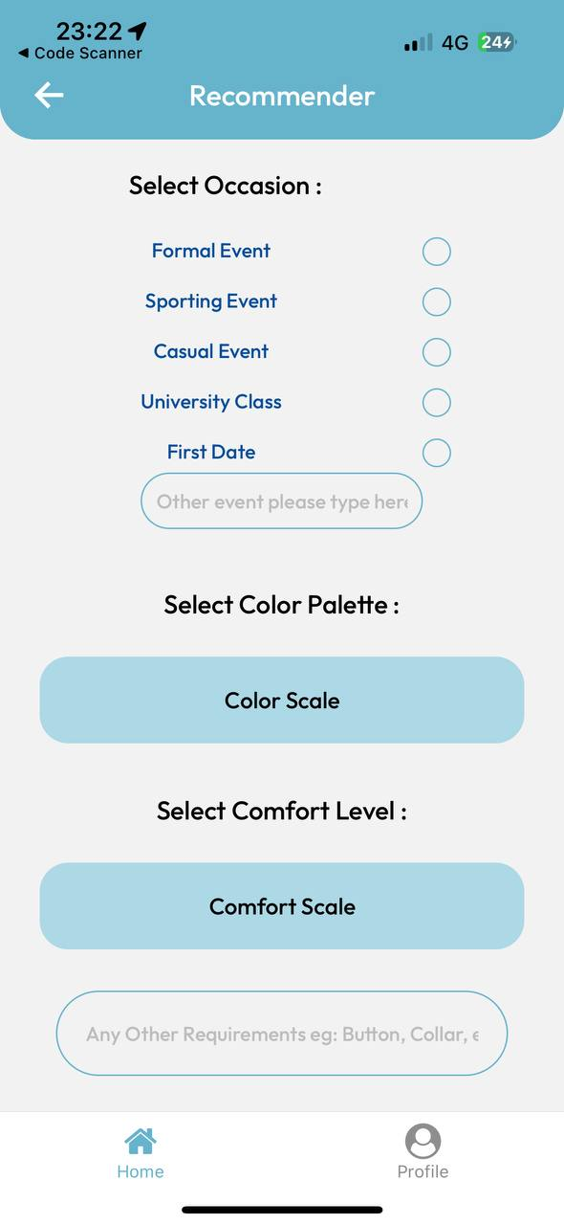

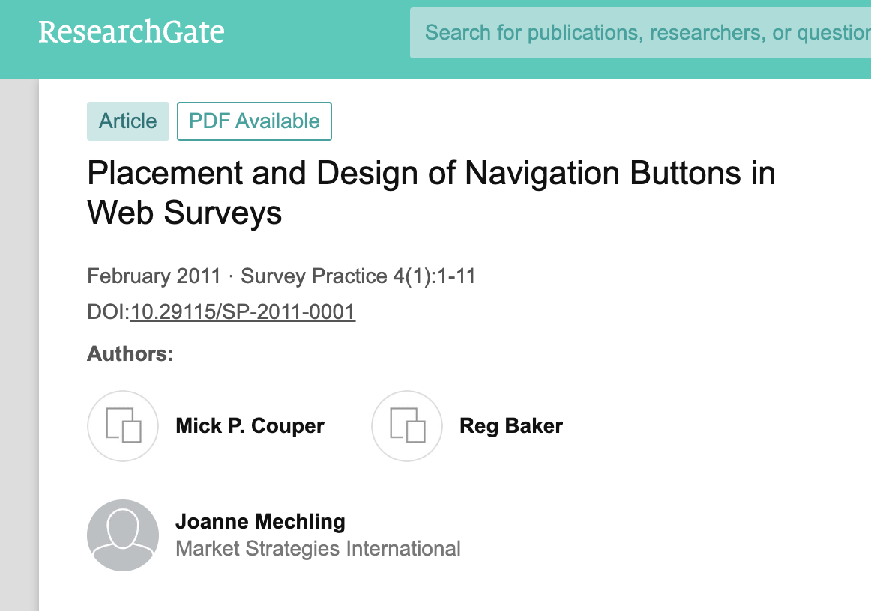
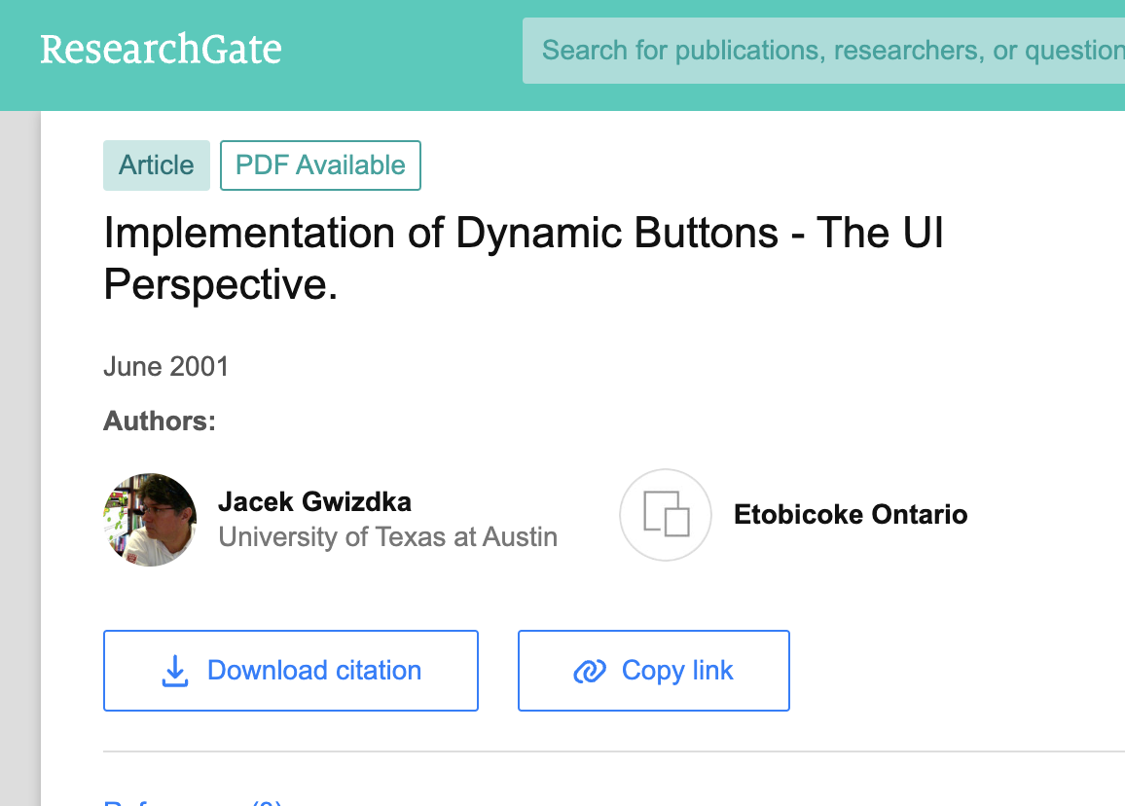
Good SE Principles
FINAL
INITIAL

Slide 30
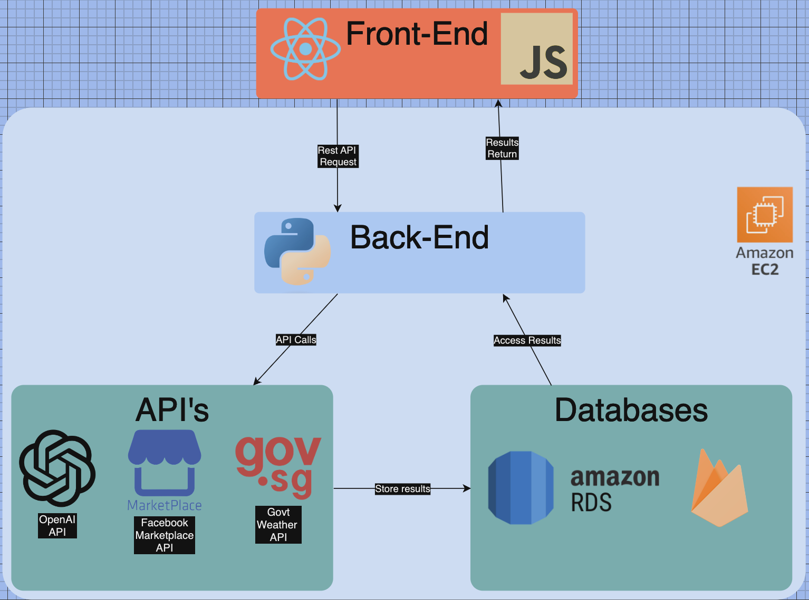
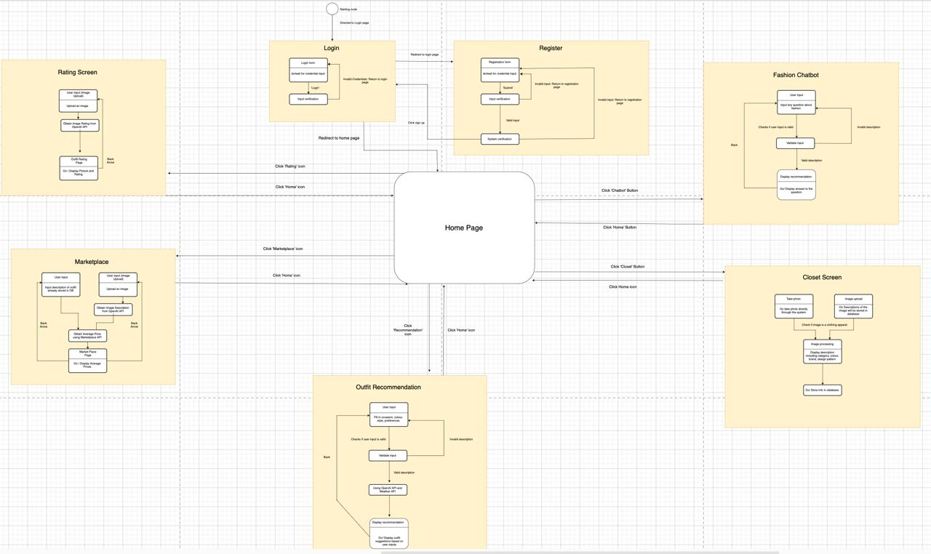
Good SE Principles

Slide 31
03
Solution Demo

Slide 32
04
Why DressSense.AI

Slide 33
Unlike anything else on the market

Slide 34
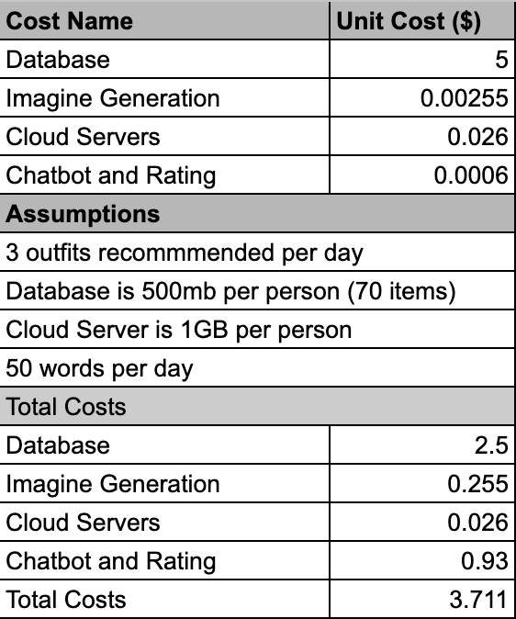
Financial Viability
$5 Monthly Subscription
26% Profit Margin

Slide 35
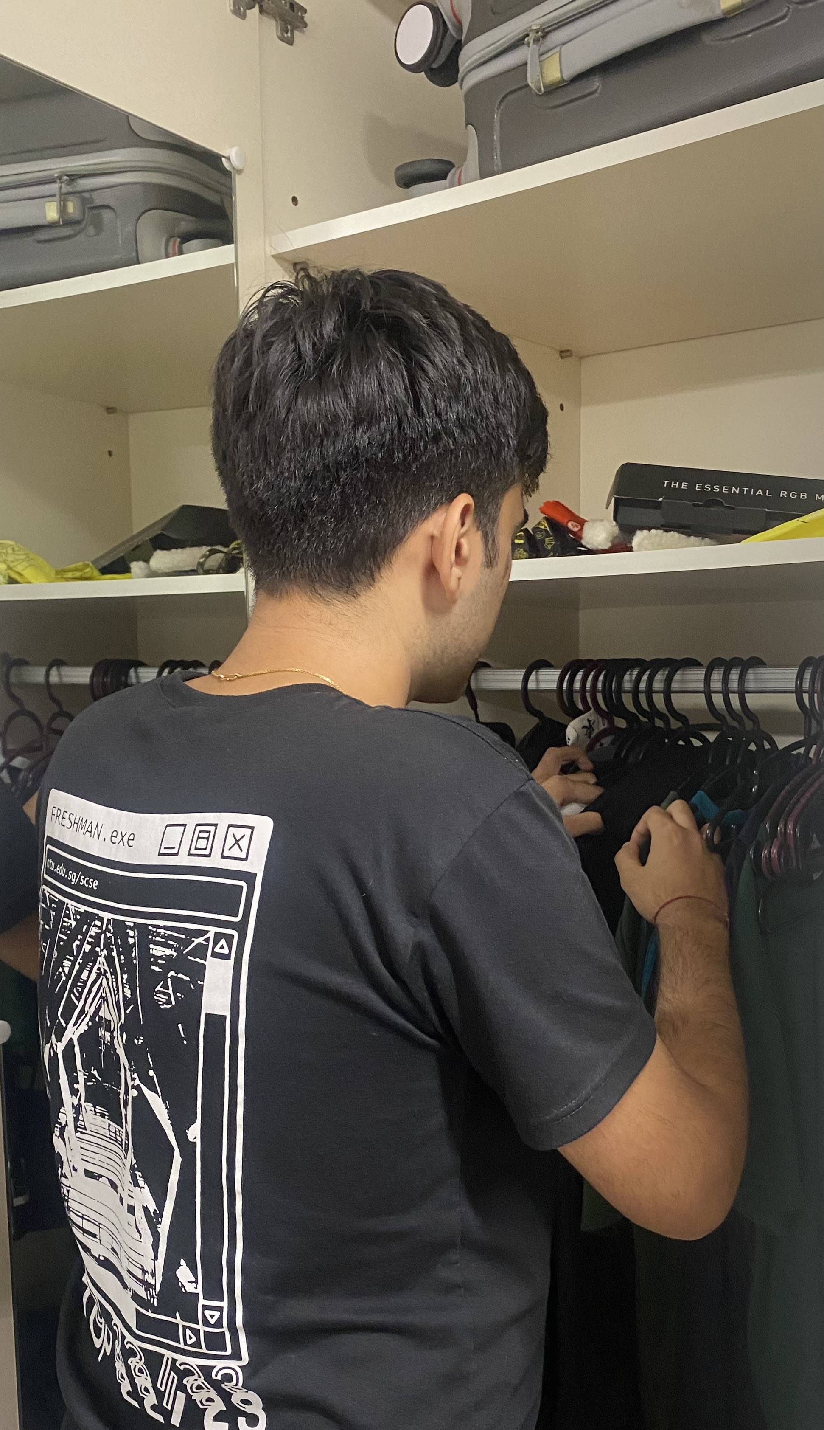
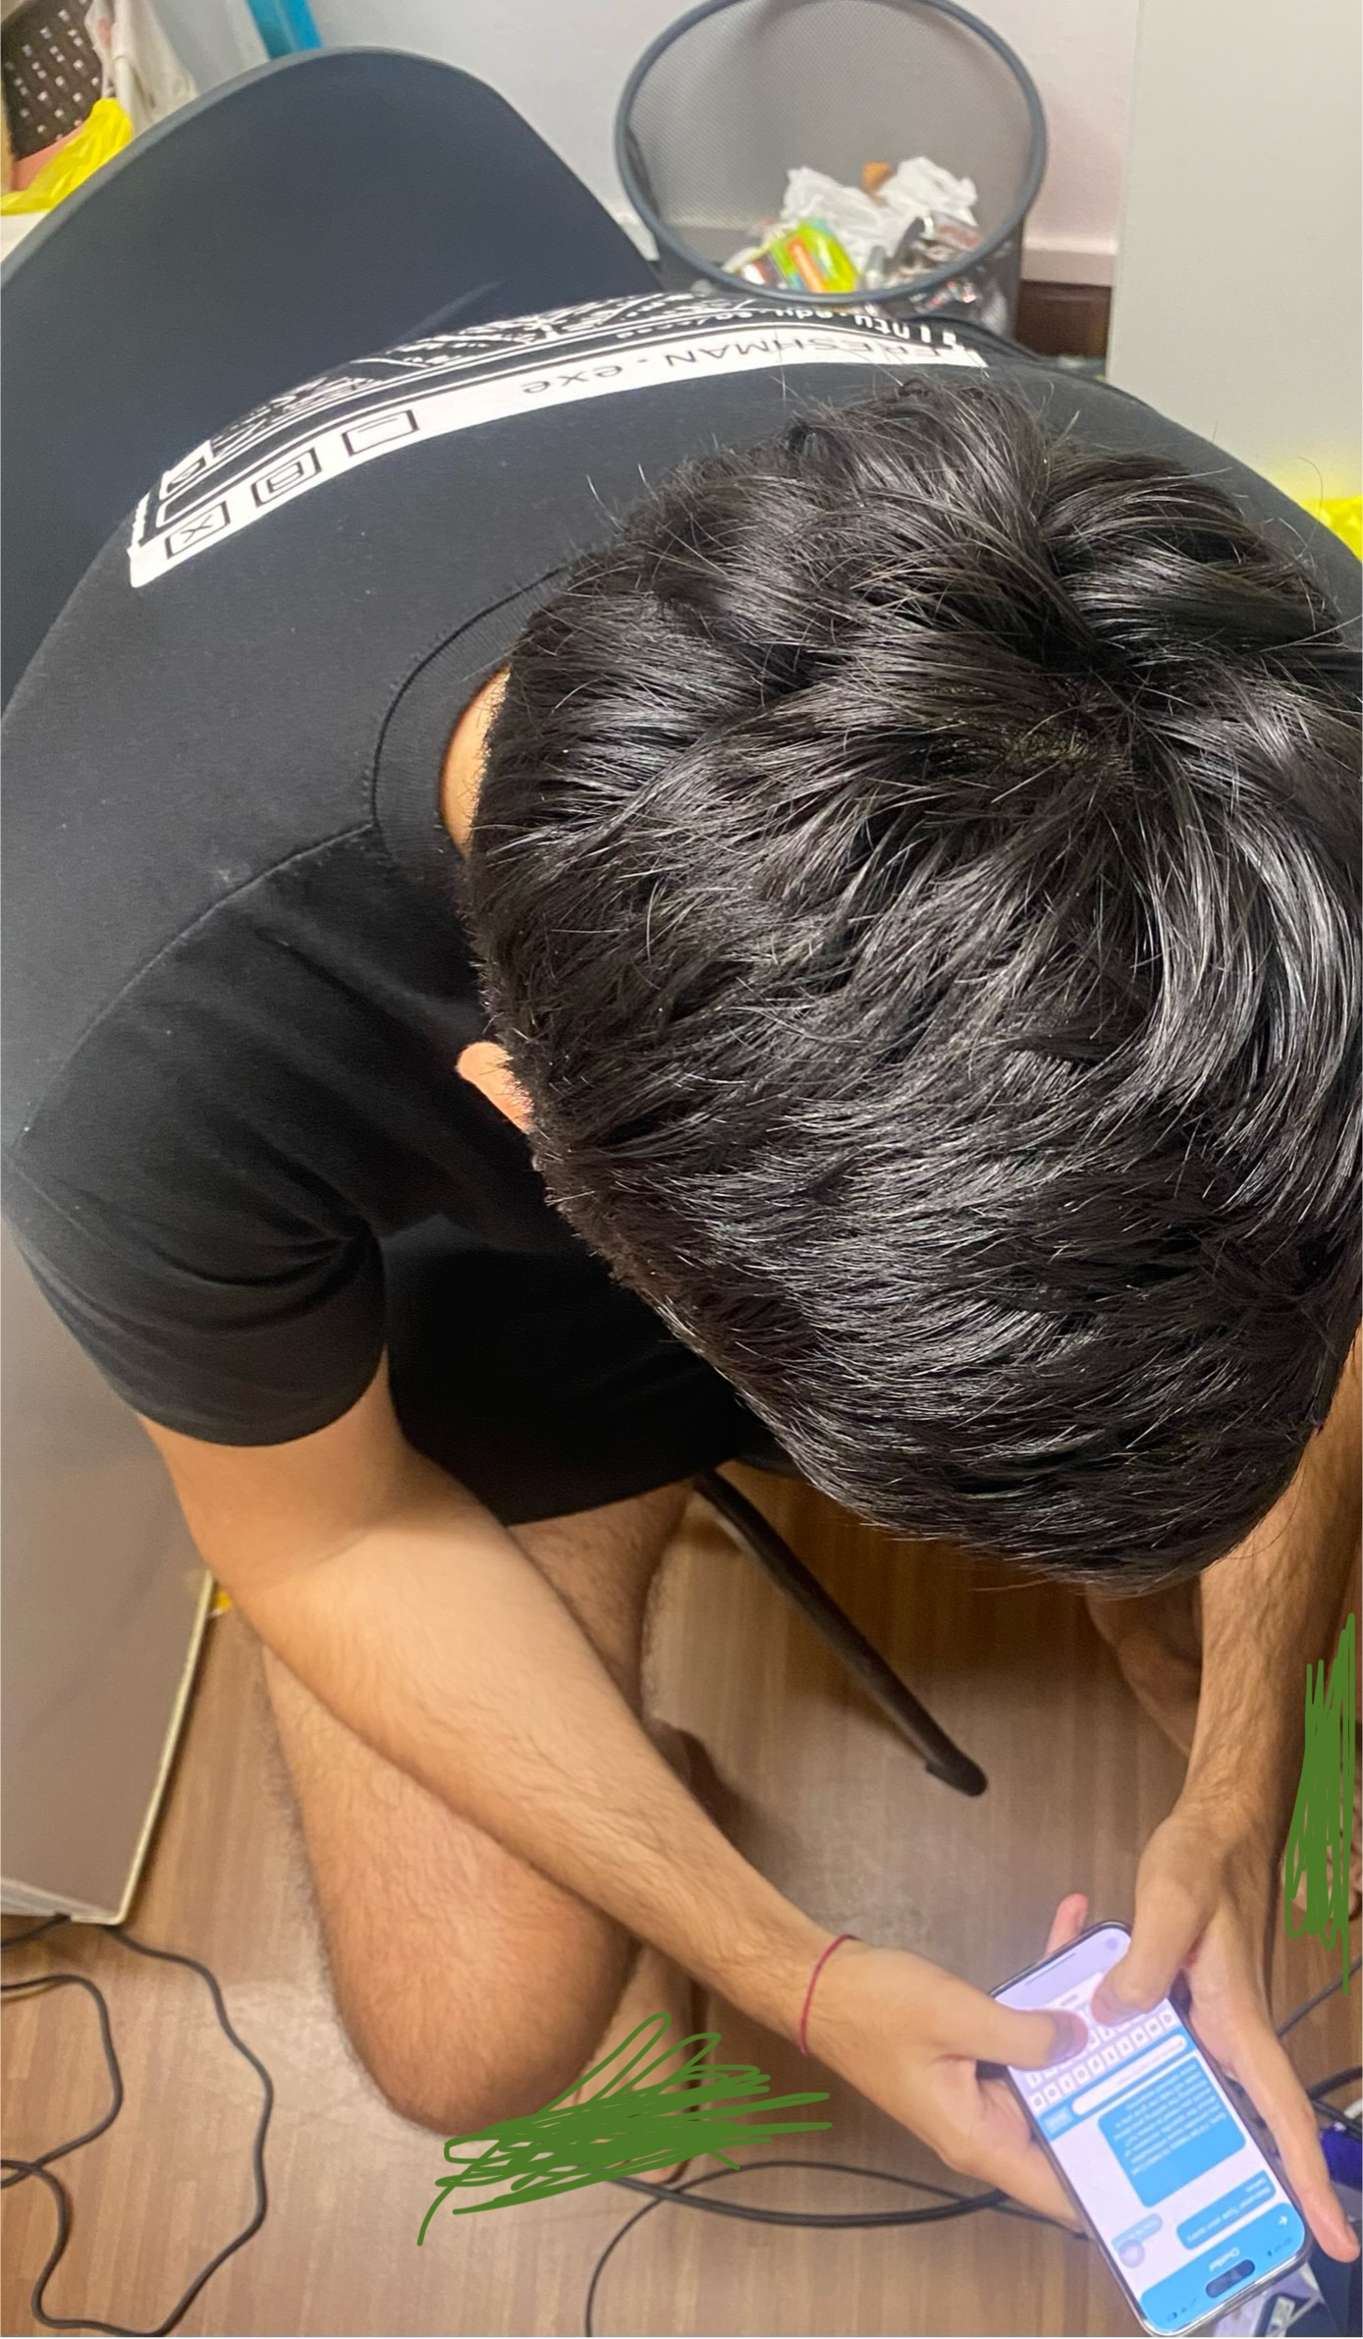
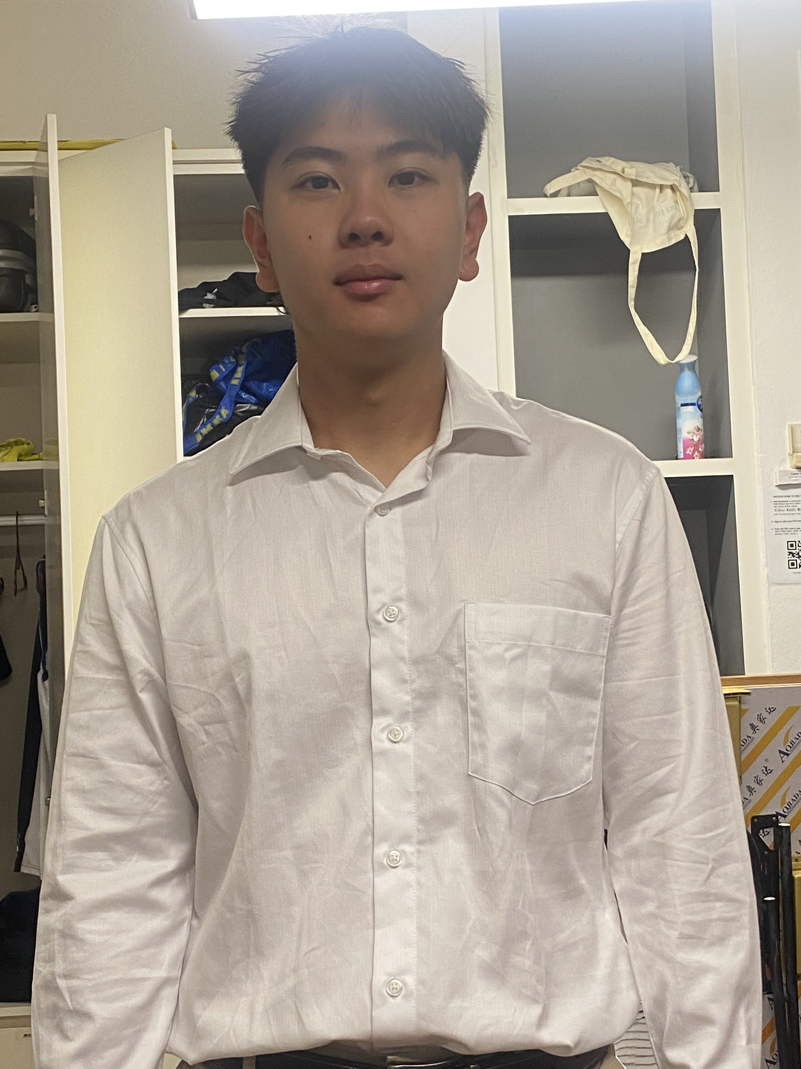
Fulfillment of the Task
No more manual searching
No more not knowing how to dress
No more listening to untailored advice
No more being dressed inappropriately for work and school

Slide 36
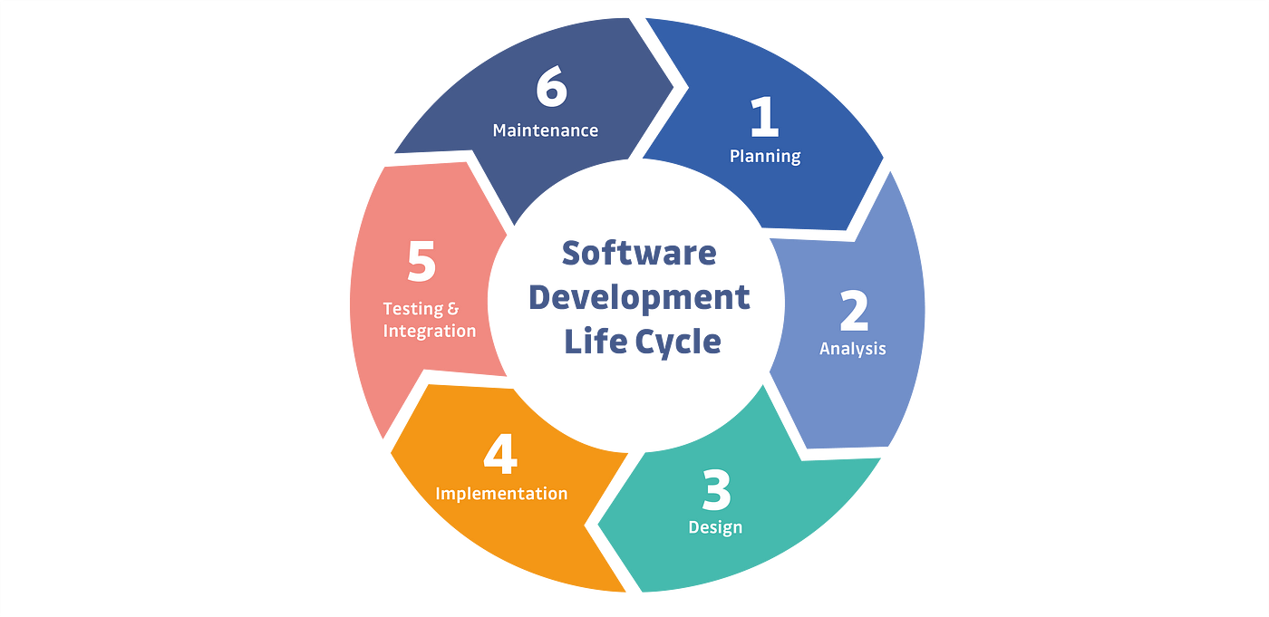
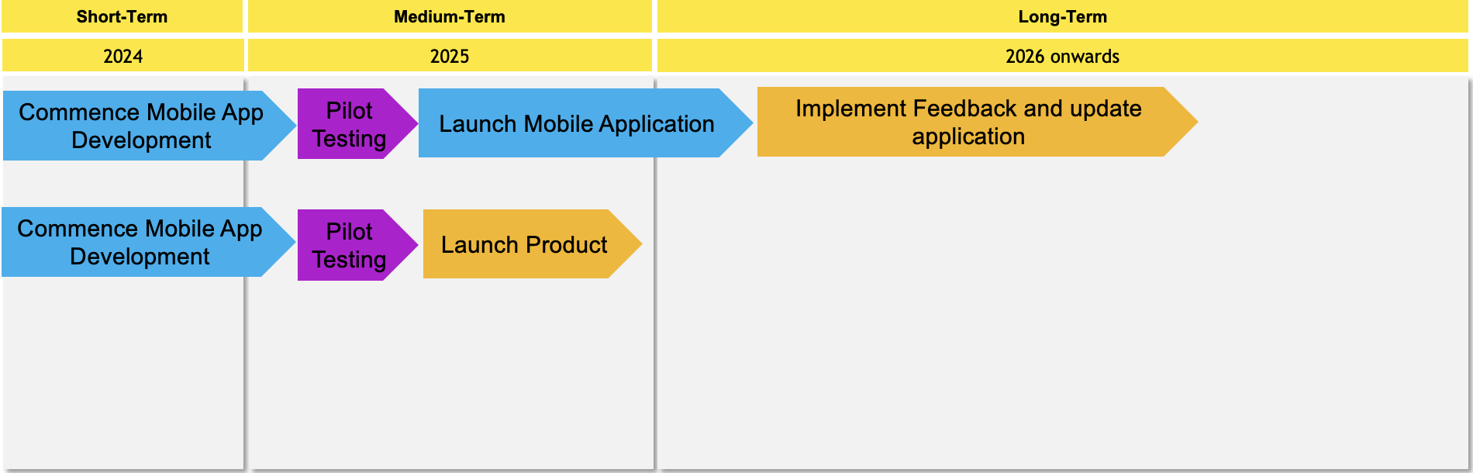
Implementation Timeline

Slide 37
THANKS!
Do you have any questions?

